Slide 1
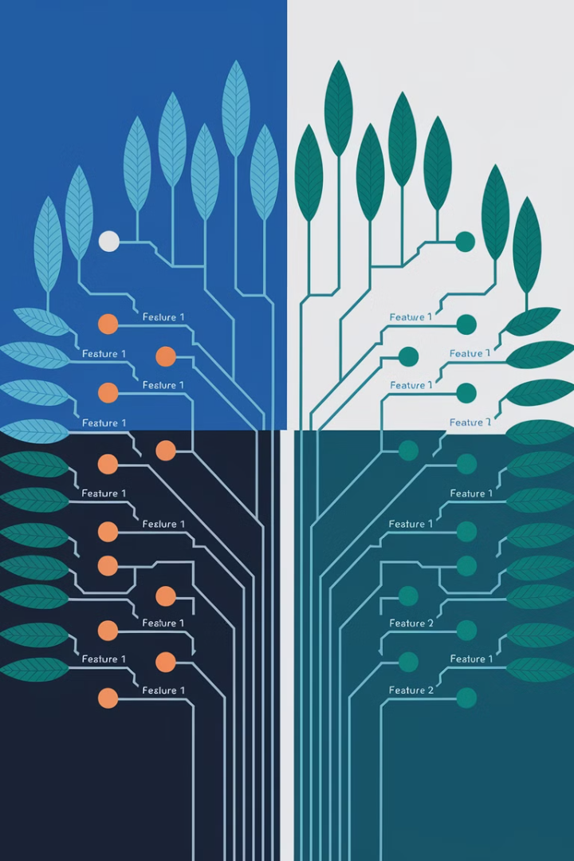
Decision Tree in Machine Learning
Discover how decision trees work as a supervised learning algorithm. This versatile method creates tree-like structures to make predictions and solve classification and regression problems.

Slide 2

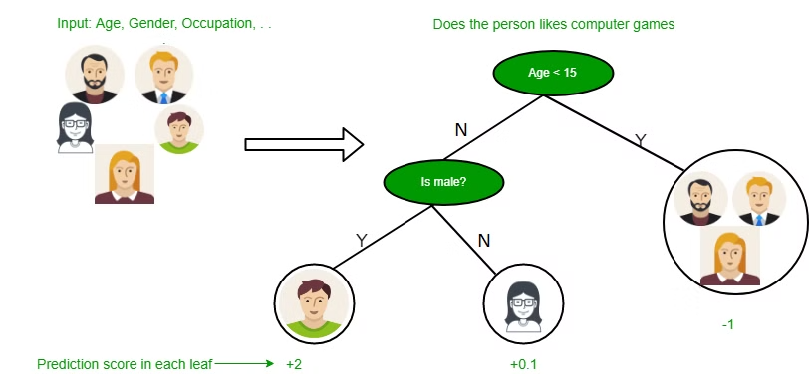
What is a Decision Tree?
1
Tree Structure
2
Versatile Applications
Internal nodes represent attribute tests. Branches show attribute values. Leaf nodes display final decisions.
Used for both classification and regression tasks. Highly interpretable models.
3
Supervised Learning
Trained on labeled data. Creates predictive models based on input features.

Slide 3


Intuition: The Umbrella Decision
Ask a Question (Root Node)
Is it raining? If yes, buy an umbrella. If no, ask another question.
More Questions (Internal Nodes)
Is it likely to rain later? If yes, buy an umbrella. If no, don't buy.
Make a Decision (Leaf Node)
Based on your answers, you either buy or skip the umbrella.

Slide 4
Basic Approach
Tree Representation
Boolean Functions
Decision Making
Each leaf node corresponds to a class label. Attributes are represented on internal nodes.
Can represent any boolean function on discrete attributes using the tree structure.
Follow the path from root to leaf to make a prediction for new data.

Slide 5

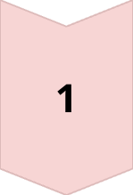
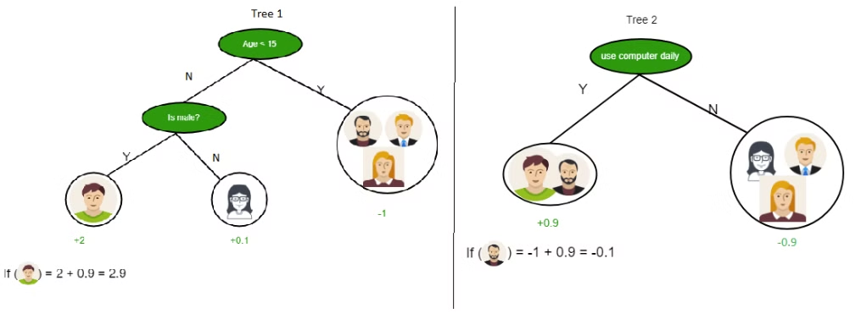
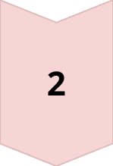
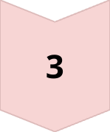
Example: Game Preferences
Age Question
Is the person's age less than 15? If yes, they likely enjoy games (+2 score).
Gender Question
If 15 or older, are they male? If yes, somewhat likely (+0.1 score).
Final Prediction
If not male, less likely to enjoy games (-1 score).

Slide 6
Using Multiple Trees
Tree 1: Demographics
Tree 2: Behavior
Combined Prediction
Questions about age and gender. Scores range from -1 to +2 based on answers.
Focuses on daily computer usage. +0.9 for daily users, -0.9 for non-users.
Final score is the sum from both trees. Higher positive scores indicate game preference.

Slide 7




Attribute Selection Measures
Information Gain
Gini Index
Selection Process
Measures impurity of a set. Lower values indicate better splits.
Measures how much uncertainty decreases after a split. Higher is better.
Choose attributes that best separate the data into homogeneous groups.

Slide 8
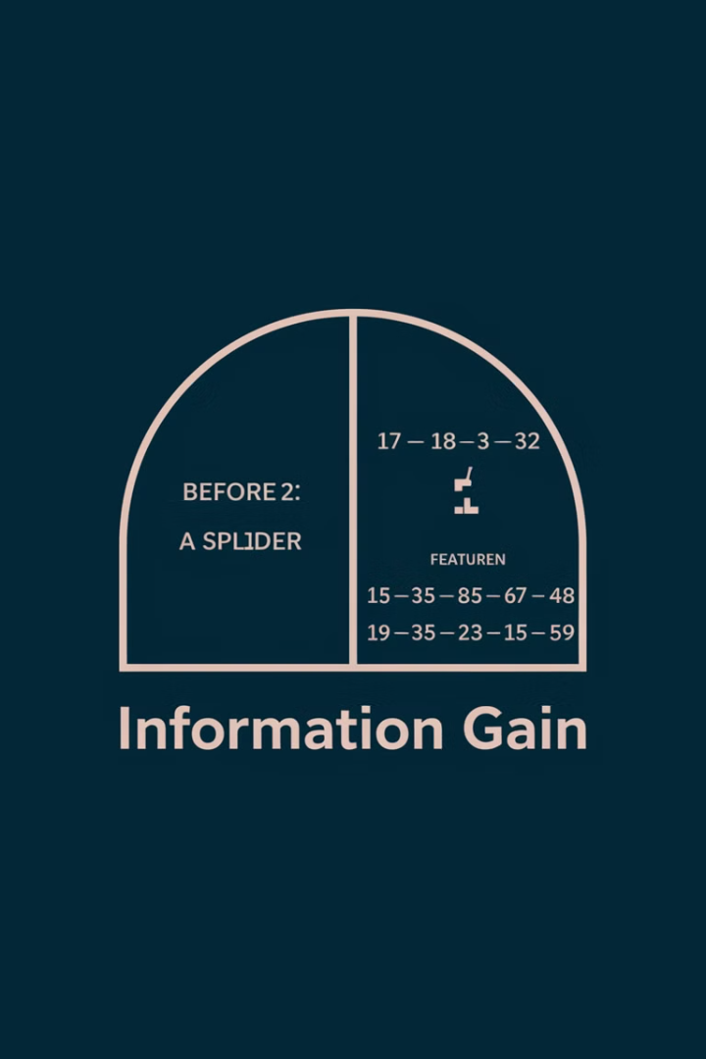
Information Gain Explained
1
Quantify Uncertainty Reduction
2
Calculation
Gain(S,A) = Entropy(S) – Sum for all values of attribute A.
Shows how useful a question is for splitting data. Good questions create clearer groups.
3
Practical Example
Perfect split: Young people bought product, old people didn't = high information gain.

Slide 9




Entropy: Measuring Uncertainty
Definition
Equal Outcomes
Measures uncertainty of a random variable. Higher entropy means more information content.
1
2
3 Yes, 3 No = high entropy (uncertain prediction).
Decision Making
4
Uniform Outcomes
Aim to reduce entropy with each split in the tree.
3
All Yes or all No = zero entropy (complete certainty).

Slide 10

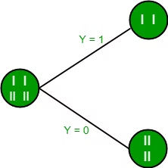
Building a Tree with Information Gain
1
Start at Root
Begin with all training instances. Calculate information gain for each attribute.
2
Choose Best Attribute
Select the attribute with highest information gain for the split.
3
Create Branches
Split the data based on attribute values. Each value creates a new branch.
4
Recursion
Repeat process on each subset until you reach pure nodes or no attributes remain.

Slide 11
Gini Index
Definition
1
Measures how often a randomly chosen element would be incorrectly identified.
Formula
2
Gini = 1 – Sum(probability^2) for each class.
Interpretation
3
Lower values indicate purer splits. Perfect purity = 0. Equal mix = 0.5.

Slide 12



Real-Life Example: Weather Activities
Sunny + Normal Humidity
Sunny + High Humidity
Rainy Weather
Decision tree predicts hiking as the activity of choice.
Decision tree suggests swimming as the preferred activity.
Decision tree recommends staying inside.

Slide 13





Decision Tree Process
Make Prediction
1
Follow tree for new data
Assign Final Labels
2
Create leaf nodes
Recursive Splitting
3
Continue until pure
Split Into Subsets
4
Based on questions
Choose Best Question
5
Start with whole dataset

Slide 14

Advantages of Decision Trees
1
Interpretability
Easy to understand and explain, even to non-technical stakeholders.
2
Versatility
Works for both classification and regression problems.
3
Visualization
Simple to visualize the decision-making process.
4
Feature Selection
Automatically identifies most important features for prediction.

Slide 15




Conclusion
Key Tool
Benefits
Decision trees model and predict outcomes based on input data through tree-like structures.
Offer interpretability, versatility, and simple visualization for various ML tasks.
1
2
Challenges
Applications
May face issues like overfitting. Understanding formation process is essential.
4
3
Valuable for both categorization and regression across diverse scenarios.

